Slide 1
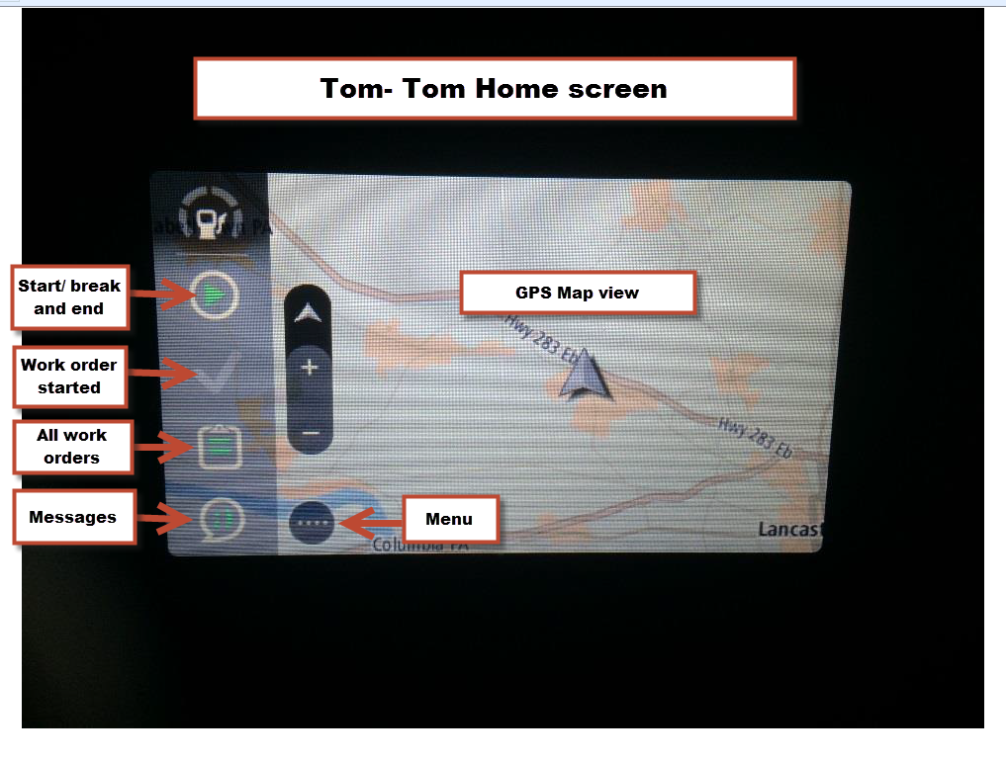
New or different truck log in #1
Notes:
If this is a first time logging into a truck, you would follow this procedure.
To log in go to the Menu button on the home screen.

Slide 2
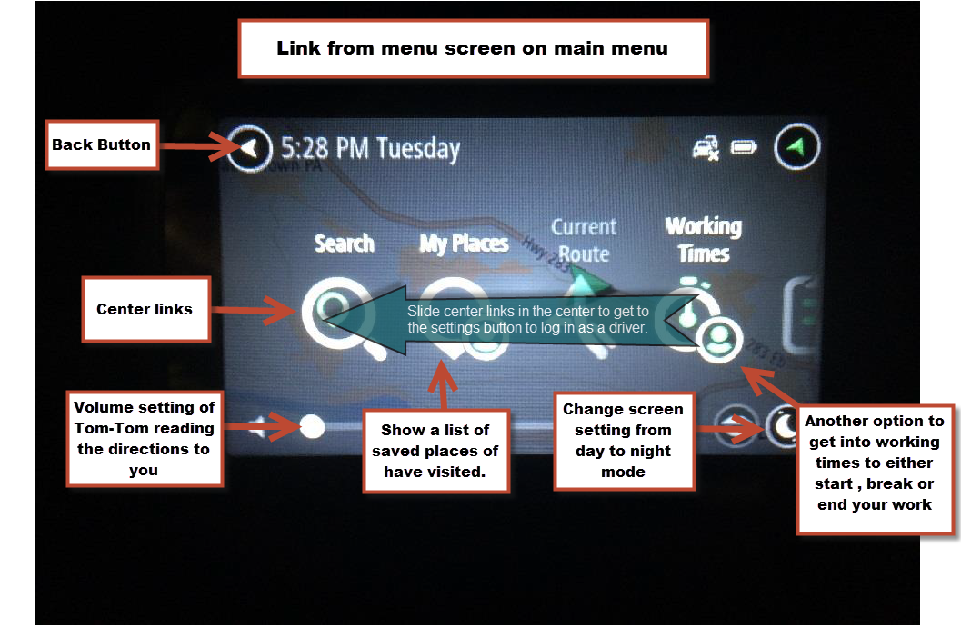
New or different truck log in #2
Notes:
1. Back button is available on most screens, you would use this to go back to previous screen.
Center links are the different options provided on the Tom-Tom unit.
Volume setting on the Tom-Tom.
Saved places can be saved for quick reference to go back to these locations.
Change screen setting from day to night if needed.
Working times. Start/ Break/ End.
Sliding center links to the left get you to settings button to be able to log in.

Slide 3
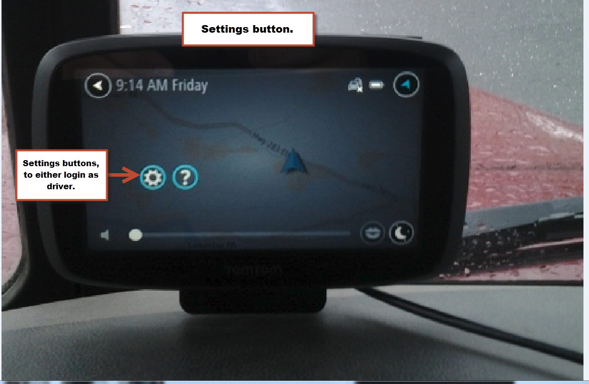
New or different truck log in #3
Notes:
Press on the settings button to log into as a driver.

Slide 4
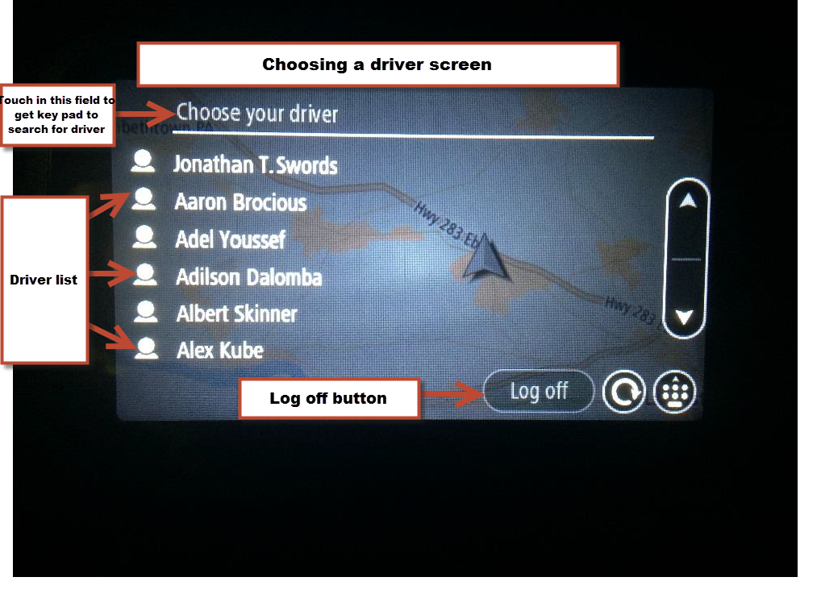
New or different truck log in #4
Notes:
Press the field “choose your driver”. You will get a letter pad that will come up, start typing in your name. As you type it will sort out all of the other names. When you see your name just press on it and you will be sent to the next screen. This will be your log in password.

Slide 5
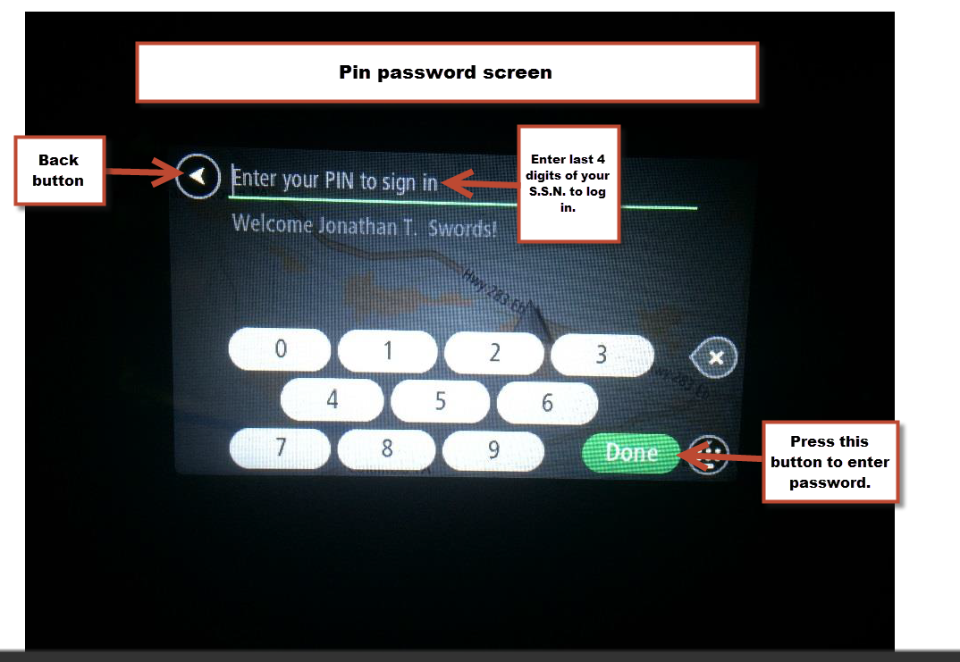
New or different truck log in #5
Notes:
Each of you will have your own distinctive password. In your case it should be the last 4 digits of your SSN. Once entered, press the green done button.

Slide 6
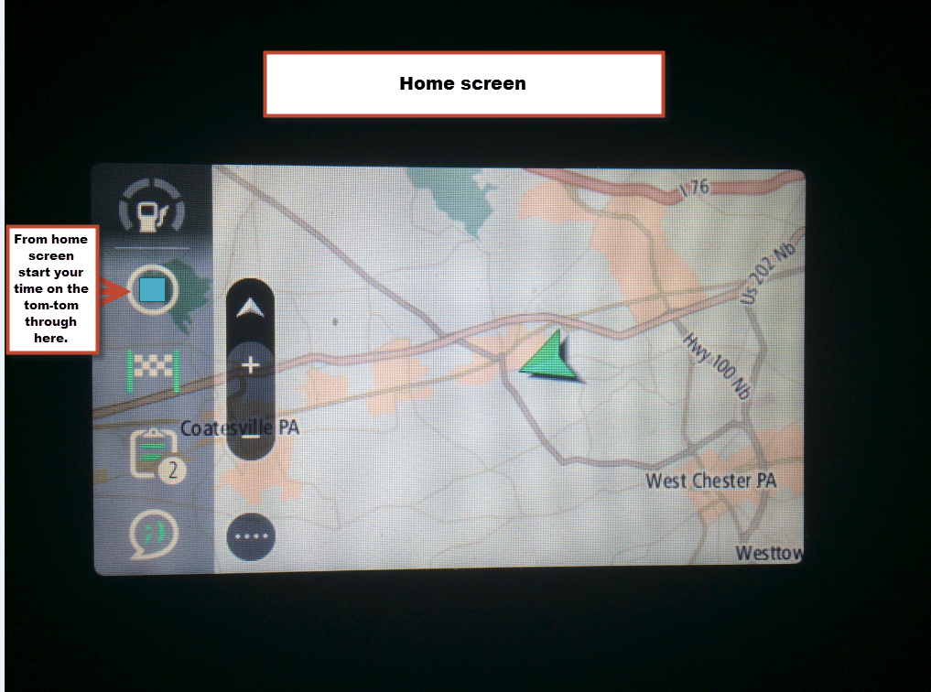
New or different truck log in #6
Notes:
From the home screen go into the indicated button to start your hours on your work day. The blue square means this that your time is stopped. You want to press this tab start your hours for the day.

Slide 7
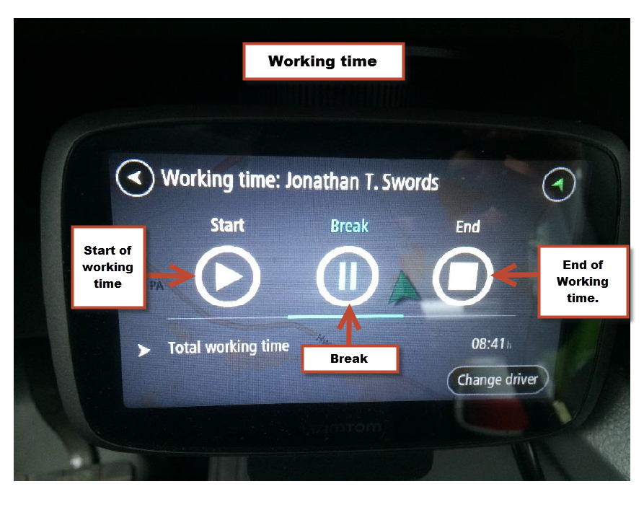
New or different truck log in #7
Notes:
Touch the start button to start the work day.

Slide 8
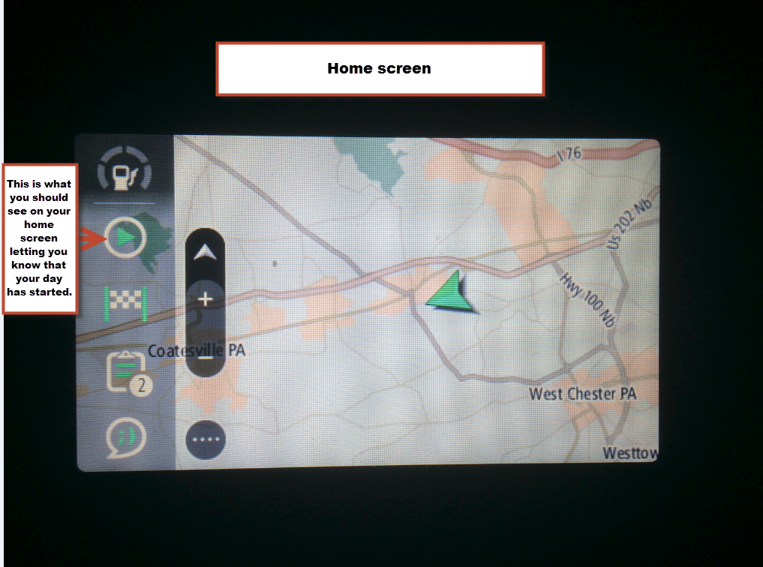
New or different truck log in #8
Notes:
This is what the Tom-Tom will look like with your time is started.

Slide 9
Return – Log in to same truck #1
Notes:
If you are returning to a truck that you was in to previously, you will see this screen at your truck. Enter your pin number and press the green “Done” button.

Slide 10
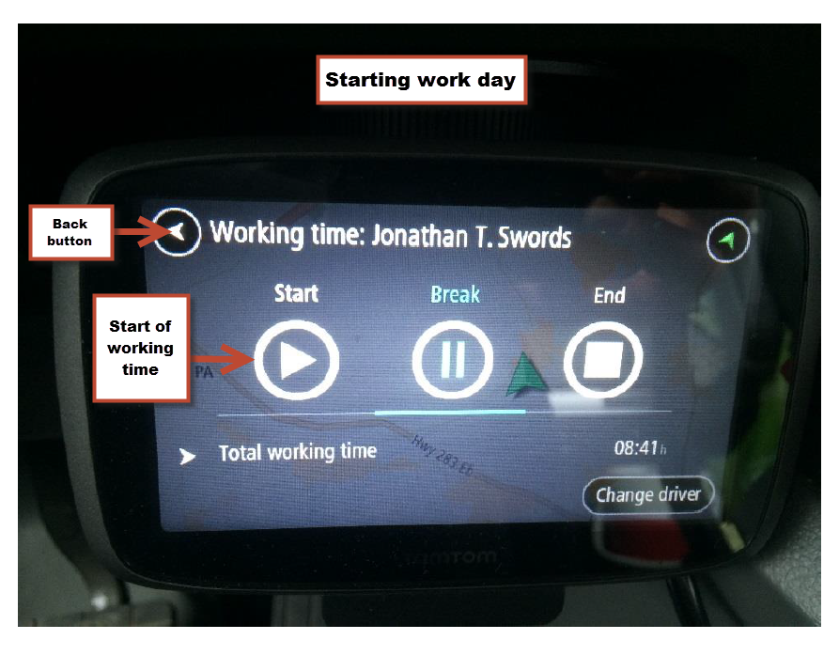
Return - Log in to same truck #2
Notes:
Once you press the “Done” button you will come to this screen. Press start the press the Back Button.

Slide 11
Return - Log in to same truck #3
Notes:
When you press the back button, you will come back to the home screen.

Slide 12
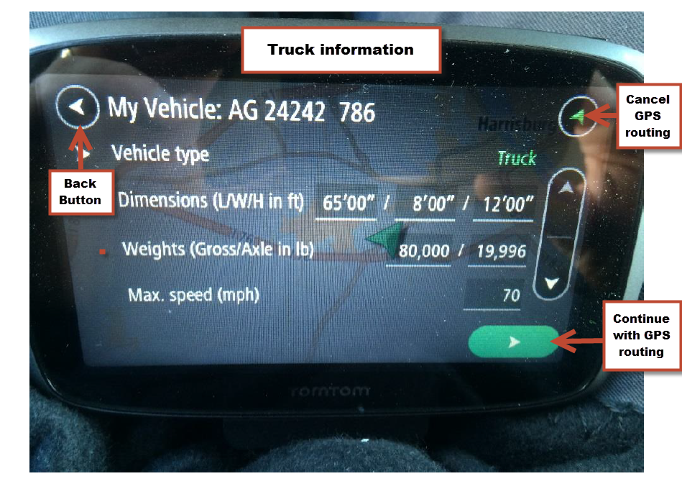
Truck information
Notes:
Once fully logged the above screen for dimensions/weight/max speed will so up when work has be assigned to you. **NOTE ** This may take a few minutes depending on signal strength. When you do get the work orders the tom – tom will begin to read on site information of the first job. You can choose bypass the directions by clicking top right button (circle with green arrow) this wont route the GPS. You need to click that button when running multiple loads. The bottom right button (rectangle white arrow) will route GPS and give you turn by turn directions

Slide 13
Work orders #1
Notes:
This is the screen that will come up after you make one of the 2 choices from the previous screen. You should see the work orders currently assigned in a number inside of a circle attached to the “All Work Orders” clipboard. If you want to see all of what you have, press on the “All Work Orders” clipboard. If you want to view the work order you are currently working on, click on “Work Order Started”.

Slide 14
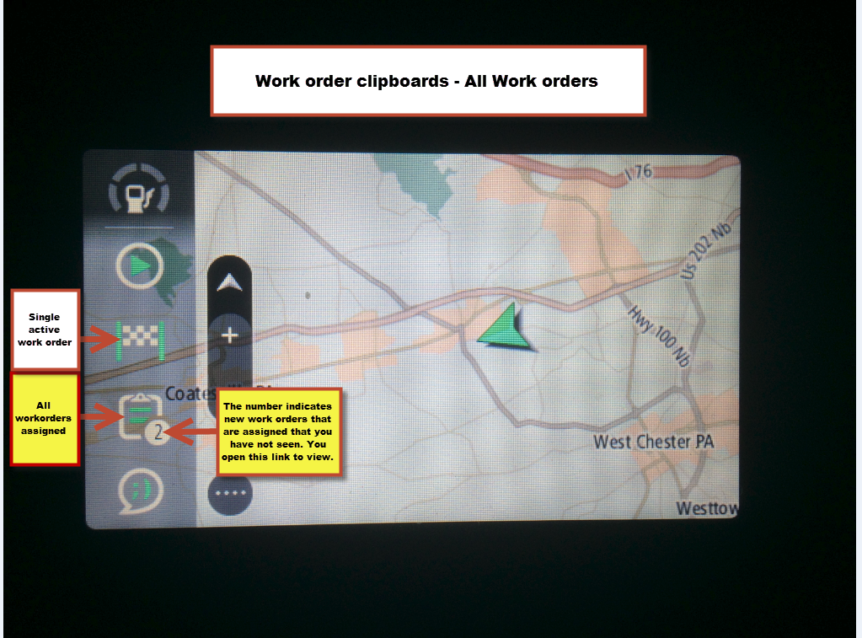
Work orders #2
Notes:
All work orders tab. This field will show all work orders assigned to you at this moment. The next slide will show what this will look like.
The number on the all work order tab indicates how many NEW work orders that have not been viewed. To view the new work orders, all you need to do is open the All Work order Tab. Once you close the numbers will go awau. You will see this number first thing in the morning or throughout the day as jobs are added.

Slide 15
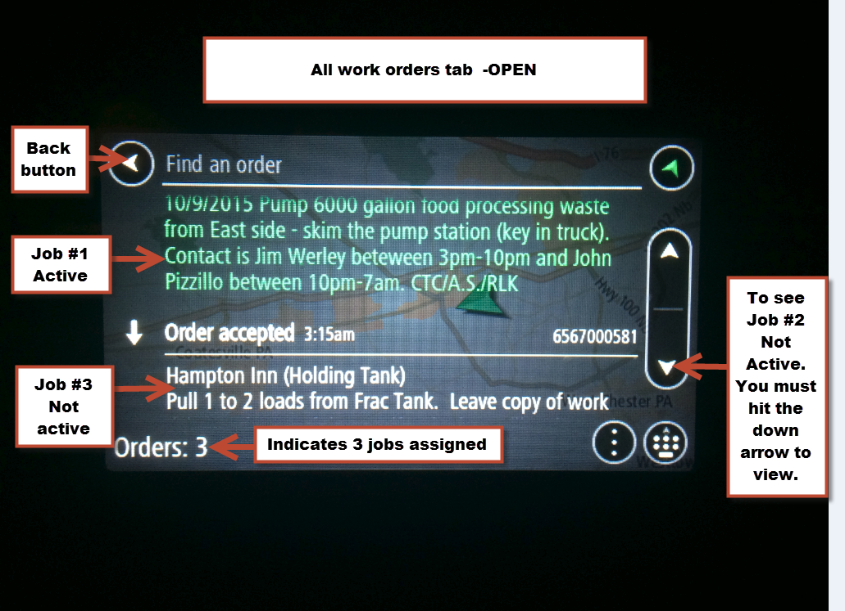
Work orders #3
Notes:
This is the All work order tab opened up. In the center you cant see Job #1 (active) This work order is highlighted in green. It is in status #2. This view can be seen from main screen as seen on next slide.
You will noticed that you can only see on this screen Job #3. That is because Job #2 is below Job #3 on this screen. The order you are working on will be at the top. The work order scheduled next will be on the bottom of the list. You can view this by pressing the down button as indicated on the tigh side fo the diagram.

Slide 16
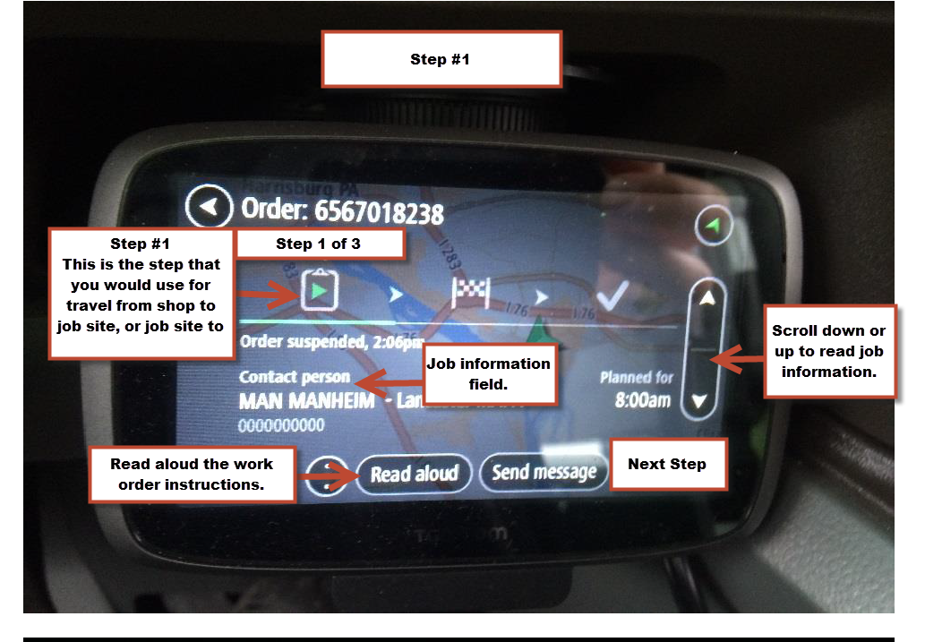
Work order #4 (Step #1)
Notes:
Once a work order is started it is automatically put into Step #1 in its status. Step #1 is travel to a job site. You can have the work order instruction re read aloud to you if needed. Using the scroll button on the right you can read the instructions if you wish to. Once on job site, press the “next step” in the bottom right corner. This is onsite time.

Slide 17
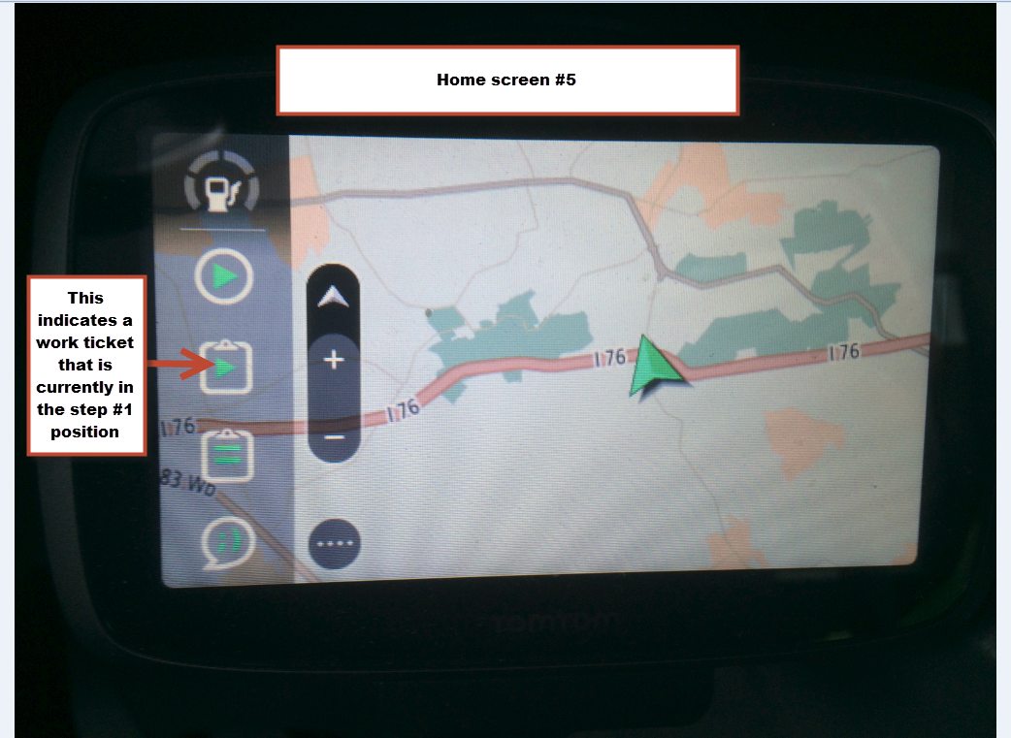
Work order #5 (Step #1)
Notes:
Step #1 is a work order that has been started or in another words you are enroute to a job site. Step #1 is travel to, either from previous job site or home base.

Slide 18
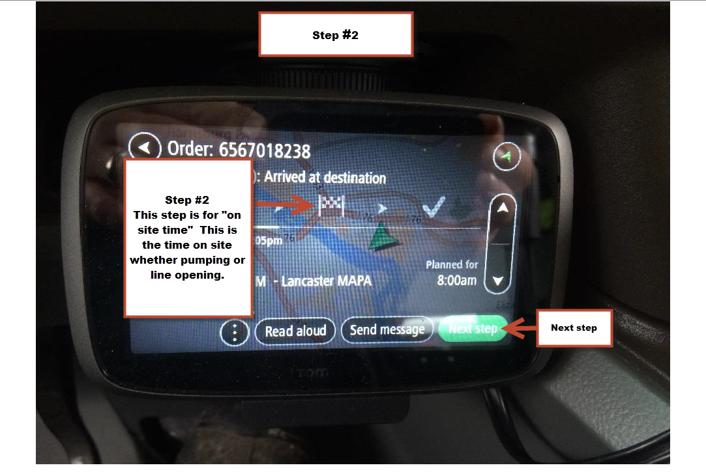
Work order #6 (Step #2)
Notes:
Step #2 is on site time. When you hit the next step button from step #1, you will see the checkered flag, this will remain on screen till finished with work on site. Once complete on site, you will hit the next step button again to complete your job. This will take you to Step #3.
Step #3 is onsite time.

Slide 19
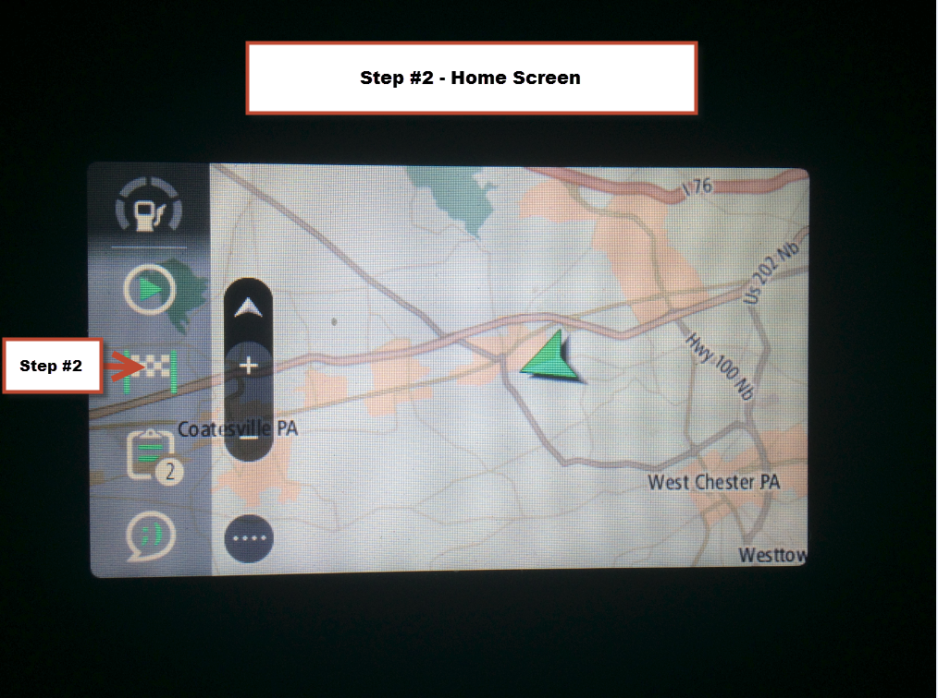
Work orders #7 (Step #2)
Notes:
Step #2 is indicated by the checkered flag. This step would be pressed when you arrive on the job site.
Step #2 – Job sight time.

Slide 20
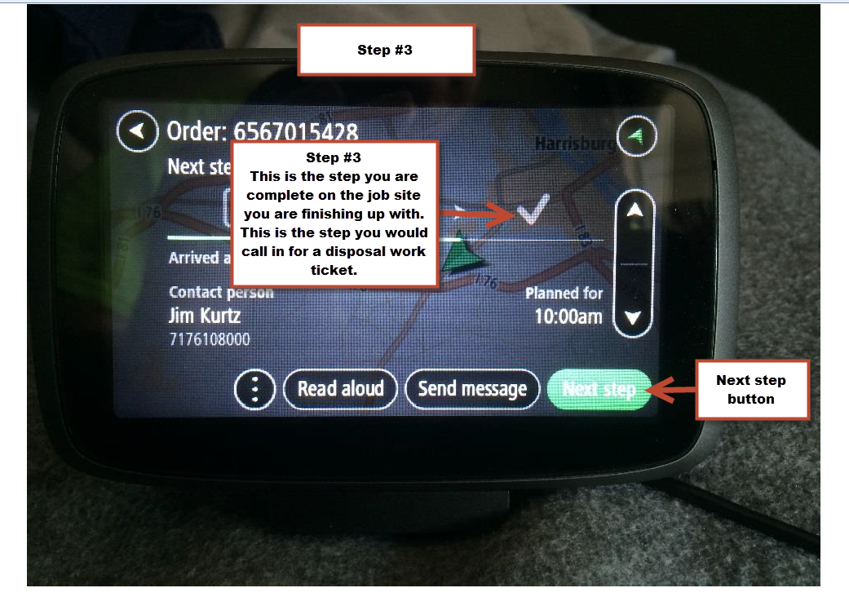
Work order #8 (Step #3)
Notes:
Step #3 is the job completed. Once you hit the next step you will be prompted with a question to move on to the next job.

Slide 21
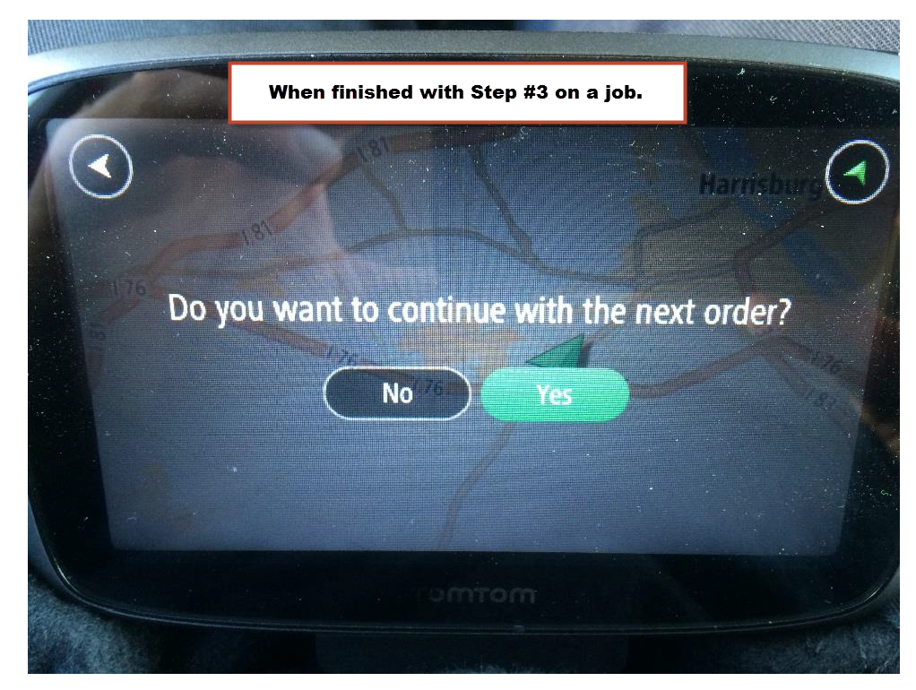
Work order #9 (Completion)
Notes:
Once you click yes, this will remove the job from your list. You will then be moved on to the next job.

Slide 22
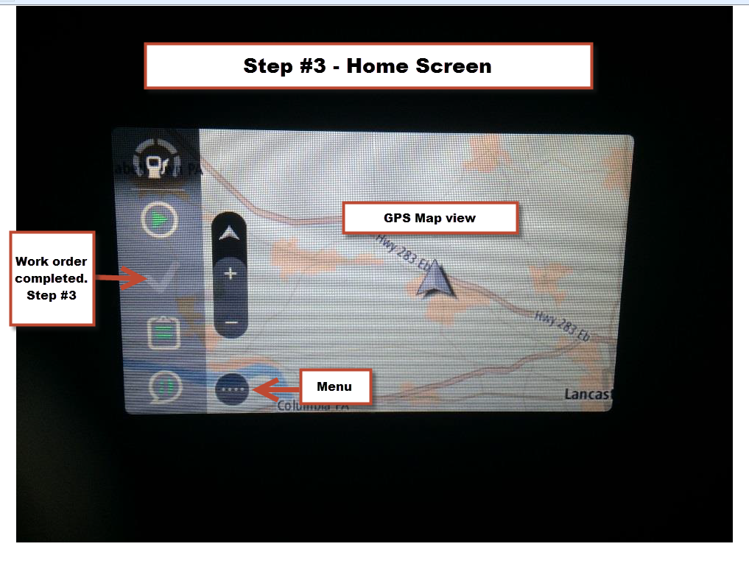
Work order #10 (Step #3)
Notes:
Step #3 is job completed. On the home screen when you see the above check mark, this is letting you know that you have no current started jobs. You may not have any more work in the all work order tab.

Slide 23
Suspending a work ticket #1
Notes:
From time to time you may need to do a work order out of a order that was originally planned. Go into the “All Work Order” clipboard.

Slide 24
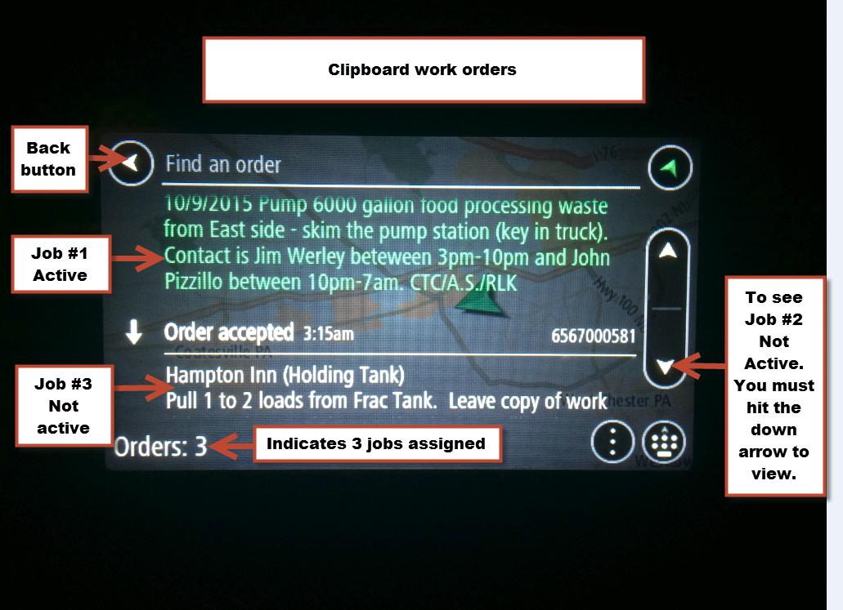
Suspending a work ticket #2
Notes:
You will see that on this screen that job #1 is active. To start another work order in place of Job#1 all you need to do is from this screen, touch Job #2 or Job #3, whichever job you need to start and answer the question, ‘do you want to suspend your current work order to start this one? Answer yes to this question. This will start the work order you need and suspend the one that was originally running.

Slide 25
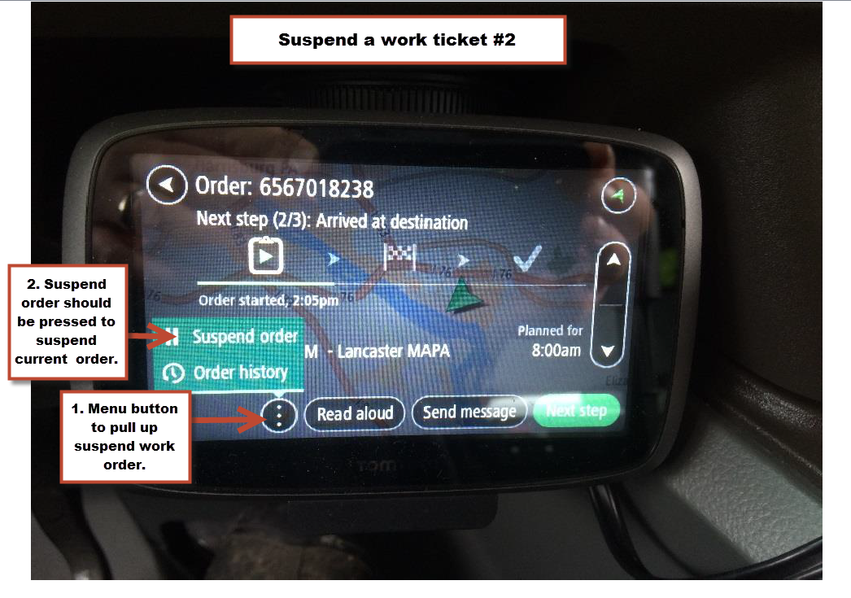
Suspending a work ticket #3
Notes:
Once you open the work ticket you want to suspend, press on the menu button (1). This will open up two other options. Press the option for “suspending order”.

Slide 26
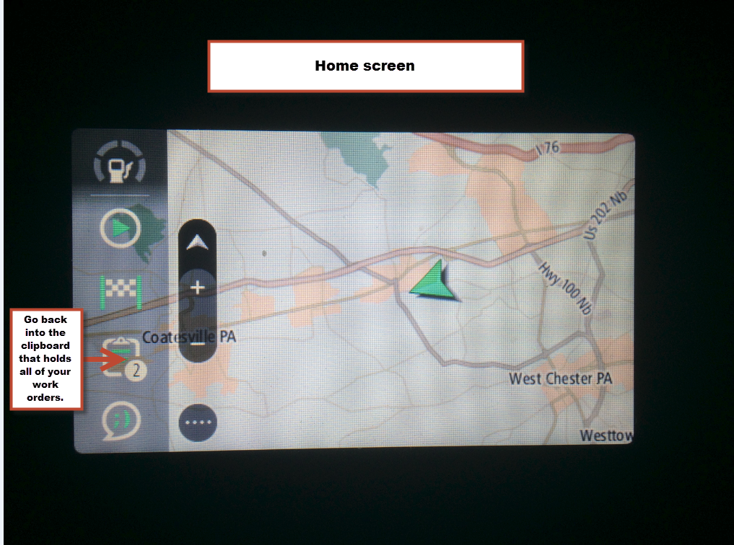
Resuming a suspended work order #1
Notes:
Go into the all work orders tab.

Slide 27
Resuming a suspended work order #2
Notes:
Click on work order you need to restart.

Slide 28
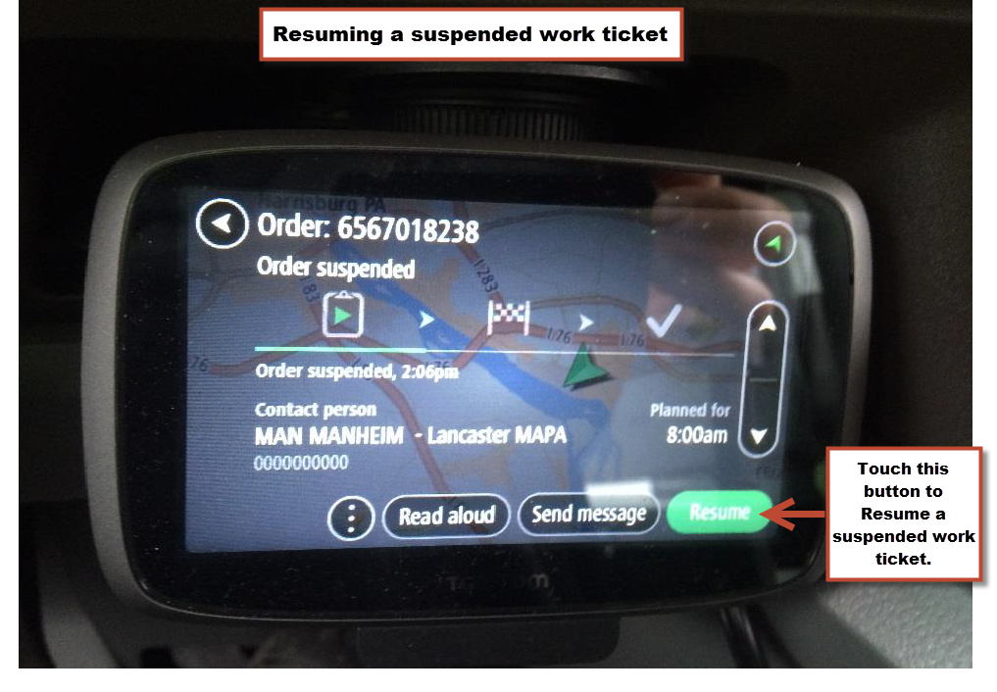
Resuming a suspended work ticket #3
Notes:
Press the green “Resume” button to restart a suspended work ticket.

Slide 29
Logging out #1
Notes:
From main menu, Press on the Menu tab.

Slide 30
Logging out #2
Notes:
Slide center links to the left to get to the settings tab.

Slide 31
Logging out #3
Notes:
Press on the settings button.

Slide 32
Logging out #4
Notes:
Press on the log out button.

Slide 33
Logging out #5
Notes:
Press the “End” button to end your work time for a day.

Slide 34

Logging out #6
Notes:
The ending or home screen should look like this. The start/ break/ end button will show a square box in the middle. The square box indicates time is stopped. If you see an arrow in this same circle, this would indicate your work time is still running.
If there are no further work orders started, this would indicate in the Work order started tab. There would be a clipboard with a arrow indicating a started or not compete work order. You want this field to show a check mark, this indicates all is complete.

